Slide 1
MCA Final Year Project (Review I) IMMERSIVE AUGMENTED REALITY WARDROBE STYLIST
Submitted to the Presidency University, Bengaluru in partial fulfillment for the award of the degree of Master of Computer Applications(MCA)
Project Number : MCA_PR214
Under the supervision of
Mr. Sakthi S Assistant Professor Presidency School of Computer Science and Engineering
Name | Roll Number
Adnan Imam | 20232MCA0248

Slide 2
Content
Problem Statement
Literature Survey
Tools and Technologies to be used
Timeline of the Project
References

Slide 3
Problem Statement
Problem Definition:
Fashion choices can be overwhelming, and individuals struggle to visualize outfits before purchasing. Traditional online shopping lacks an immersive experience, leading to dissatisfaction and high return rates.
Relevance and Significance:
An augmented reality-based wardrobe stylist can enhance shopping experiences by allowing users to visualize outfits in real time, improving confidence in fashion choices and reducing returns.
Current Gaps in Existing Solutions:
Lack of personalization in virtual try-ons.
High computational requirements for real-time rendering.
Research-Oriented Approach:
This project aims to develop an interactive AR wardrobe that enables users to virtually try on clothes using machine learning and augmented reality techniques.

Slide 4
Literature Review
S. No | Title of Paper | Year | Methodology Used | Challenges Faced | Advantages | Disadvantages
1 | AI-Powered Fashion Recommendation System Using Deep Learning | 2023 | Deep Learning, Neural Networks | Requires large datasets, model interpretability issues | Enhanced recommendation accuracy, improved personalization | Requires continuous model training, privacy concerns
2 | A Study on AI-Based Personalized Fashion Recommendation Systems | 2023 | AI Algorithms, Recommendation Systems | Bias in recommendation systems, high dependency on user data | Better user engagement, higher conversion rates | Over-reliance on user data, potential inaccuracies
3 | Virtual Fashion Stylist with AI-Generated Wardrobe Capsule Suggestions | 2024 | Computer Vision, AI-based Virtual Assistants | Limited fashion dataset coverage, difficulty in trend adaptation | Automated styling, user-friendly virtual assistant | Limited scalability, high computation requirements
4 | AI-Driven Personalized Fashion Stylist | 2023 | Big Data Analytics, AI, Machine Learning | Scalability issues, difficulty in maintaining accuracy across regions | More precise fashion predictions, better shopping experiences | Data privacy concerns, requires significant processing power
5 | Augmented Reality for Virtual Try-On | 2021 | AR-based clothing visualization using computer vision | Device compatibility issues, latency in rendering | Enhanced shopping experience, reduces returns | High processing power needed

Slide 5
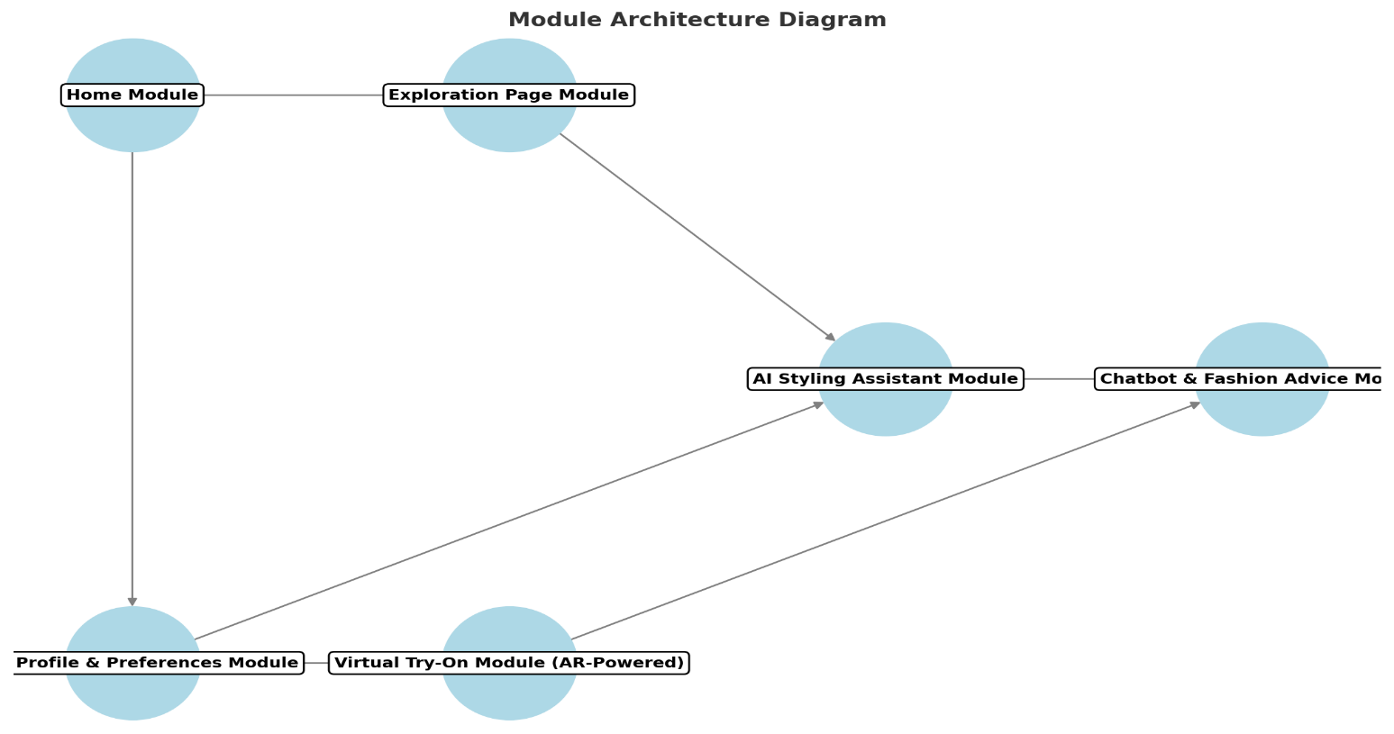
Module Design
The modular architecture of the project is designed to enhance scalability, maintainability, and efficiency by dividing the system into distinct, interdependent components. Each module focuses on a specific functionality, enabling seamless integration and easier debugging. It enables parallel development, optimized performance, and better security by isolating sensitive data within specific components.

Slide 6
Module Design
Modular Breakdown
Module 1: Home Module - Serves as the main dashboard, providing a personalized feed with fashion recommendations, user activity, and quick access to key features.
Module 2: Exploration Page Module - Allows users to explore trending styles, fashion inspirations, new collections, and AI-curated looks.
Module 3: User Profile & Preferences Module - Stores user details, style preferences, wardrobe items, and past selections for a personalized experience.
Module 4: Virtual Try-On Module (AR-Powered) - Enables users to try on outfits virtually using augmented reality for better decision-making.
Module 5: AI Styling Assistant Module - Provides personalized outfit recommendations based on weather, events, body type, and latest trends.
Module 6: Chatbot & Fashion Advice Module (NLP-Based) - Offers real-time fashion tips, trend analysis, and Q&A assistance via an AI-powered chatbot.
Module 7: Wardrobe Management Module - Helps users organize, categorize, and mix-match their existing wardrobe for better outfit planning.

Slide 7
Tools And Technologies To Be Used
Development Tools: Android Studio, VS Code
Programming Languages: Dart, JavaScript, Python
Frameworks/Libraries: Flutter, React Native, TensorFlow, PyTorch, ARCore, ARKit
Database: Firebase, Flask/Django
Version Control: Git, GitHub
Additional Tools: Google Colab (Cloud Training), Figma (UI/UX), Sketchfab/Blender (3D Models)

Slide 8
Github Link
Immersive-Augmented-Reality-Wardrobe-Stylist-

Slide 9
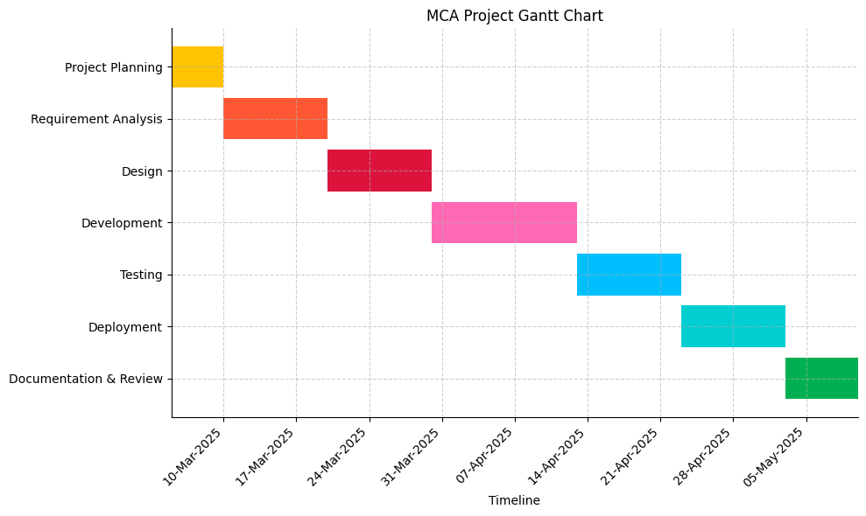
Timeline of the Project (Gantt Chart)

Slide 10
References
Karthik, M., Sharma, A., Raj, A., & Jeyakumar, P. (2023). AI-powered fashion recommendation system using deep learning. Fashion and Textiles, 10(1), 1-16. https://fashionandtextiles.springeropen.com/counter/pdf/10.1186/s40691-023-00360-w.pdf
Kumar, S., Patel, R., & Sharma, V. (2023). A study on AI-based personalized fashion recommendation systems. International Journal of Research Publication and Reviews, 5(12), 412-419. https://ijrpr.com/uploads/V5ISSUE12/IJRPR36107.pdf
Srishti, K. P., Taj, S., Prerana, D. V., Hegde, S. U., & Singh, T. S. B. (2024). Virtual fashion stylist with AI-generated wardrobe capsule suggestions. Journal of Emerging Technologies and Innovative Research, 11(11), 311–314.
https://www.jetir.org/papers/JETIR2411533.pdf
Udavant, O., Kumari, R., Kumar, R., & Chikane, M. (2023). AI-driven personalized fashion stylist. International Research Journal of Modernization in Engineering, Technology and Science, 5(11), 2363–2364. https://www.irjmets.com/uploadedfiles/paper//issue_11_november_2023/46594/final/fin_irjmets1700834106.pdf

Slide 11
References
AI-Powered Fashion Recommendations (2022)- This paper discusses the integration of AI in fashion recommendation systems, focusing on machine learning algorithms to enhance user experience. Custom AI Agents | Springs
Smart Wardrobe Management Using AI (2023)- This research focuses on AI applications in managing personal wardrobes, offering outfit suggestions based on user preferences. LeewayHertz - AI Development Company
Shaghayegh Shirkhani, Hamam Mokayed, Rajkumar Saini, Hum Yan Chai (2023). Study of AI-Driven Fashion Recommender Systems. A Springer Nature Journal. SN Computer Science 4:514 https://link.springer.com/article/10.1007/s42979-023-01932-9
Orestis Sarakatsanos, Anastasios Papazoglou‑Chalikias, Machi Boikou, Elisavet Chatzilari, Michaela Jauk, Ursina Hafiger, Spiros Nikolopoulos, Ioannis Kompatsiaris (2024). VR Designer: enhancing fashion showcases through immersive virtual garment fitting. A Springer Nature Journal. Virtual Reality (2024) 28:70 https://link.springer.com/article/10.1007/s10055-024-00945-w

Slide 12


